Slide 1
APPLICATION OF HEALTHCARE SIMULATION AND OPTIMIZATION FOR DIAGNOSIS PROCESS IN HOSPITAL: A CASE STUDY OF CHO RAY HOSPITAL
Student: Nguyen Minh Hieu
ID: IELSIU17015
Thesis advisor: M.SC. Nguyen Hoang Huy

Slide 2
Chapter 1. Introduction
Problems
- Hospital facing overcrowding
- High patients waiting time
- Lack of facilities needed
Objectives
- Develop a simulation model
- Identify bottlenecks
- Find solutions to reduce patient waiting time and others obstacle.
Scopes
Use data from Cho Ray hospital as an input
Focus on general examination process (8 clinic room and 8 types of test)
Limitations
Data size is quite small
Can not cover all the function room and resources

Slide 3
Chapter 2. Related work
Key reference: “Reducing delay in healthcare delivery at outpatients clinics using discrete event,” vol. 11, pp. 185–195, 2012.
Authors
Al-Araidah, O.
Boran, A.
Wahsheh, A.
Objectives
Reduce patient waiting time
Improve hospital services
Methodology
Using Discrete Event Simulation (DES)
Using hypothesis test to check the validate of the model

Slide 4
Chapter 3. Methodology
Approach comparison and selection
Discrete Event Simulation (DES) | System Dynamics (SD) | Agent-Based Simulation (ABS)
Individual focus (Entity) | Group focus (Cohort) | Individual focus (Agent)
Discrete-time intervals | Stepped time intervals | Stepped time intervals
Event derive the simulation | Rates derive the simulation | Local Environment and agents derive the simulation
Selection:
Discrete Event Simulation approach
Arena Simulation as software

Slide 5
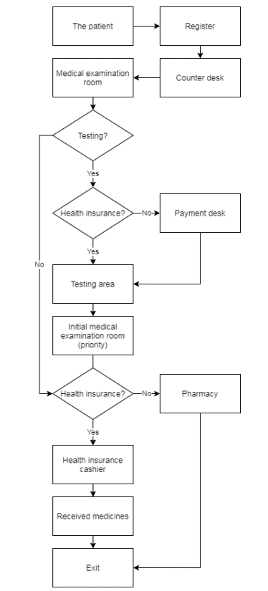
Model conceptual design
2 types of patients:
insurance
non-insurance
8 medical examination room
8 types of test:
- Take blood - MRI
- Take urine - ECG
- X-ray - Ultrasound
- CT - Endoscopic

Slide 6
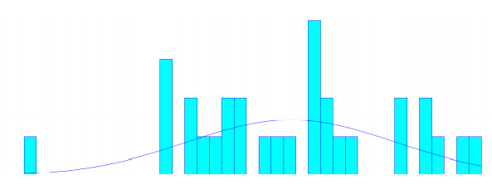
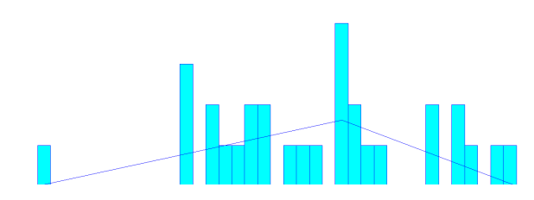
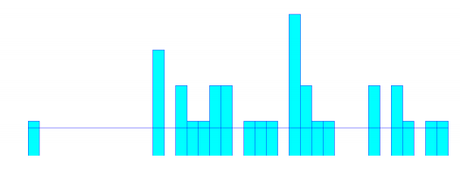
Chapter 4. Data collection and analysis
The number of patients per day
The number of patients arriving at the hospital from 5:00 am to 2:00 is divided into 9 time frames.
The number of function rooms and resources
The number of function, resource rooms and their names in the model.
The distance between area
The travel distance matrix between 6 area in the hospital.
The ratio of test
The ratio was collected through a survey of 100 patients.
The processing time analysis
The processing time data are collected by record the time between two patients come in and out.
The data then put into the Input Analyzer to find the most suitable distribution.

Slide 7
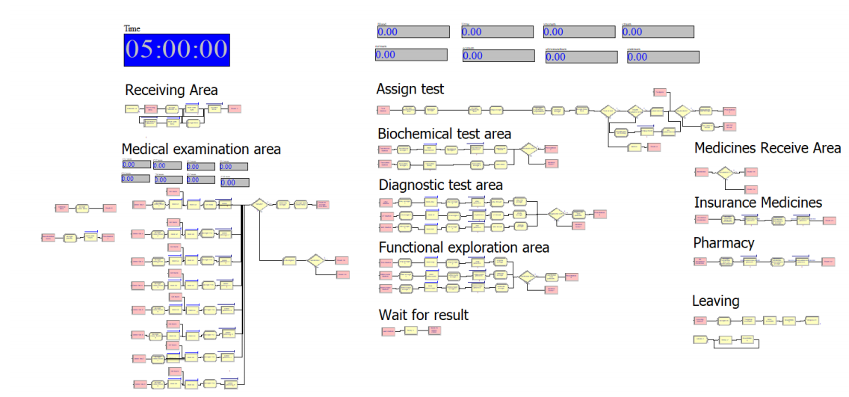
Chapter 5. Modelling
Using 12 basic modules:
Create
Dispose
Station
Route
Assign
Hold
Process
Record
Decide
Delay
Pickstation
ReadWrite

Slide 8
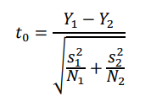
Chapter 5. Modelling
Model validation:
Data: the number of patients out of a room within 1 hour in 2 days
Replication: 4
Method: The two-sample t-test
Significant level: 95%
The test statistic is:
Where:
- Y1 and Y2 are the samples means
- s1 and s2 are sample standard deviation
- N1 and N2 are the sizes

Slide 9
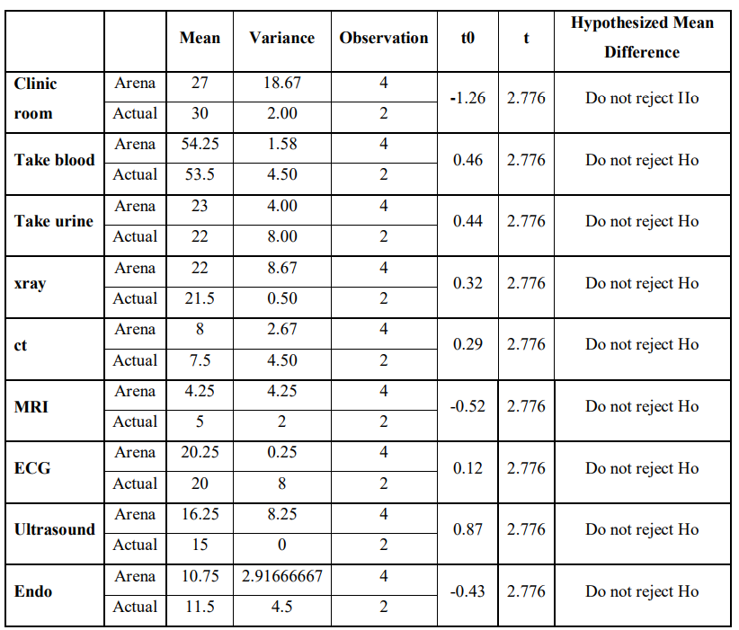
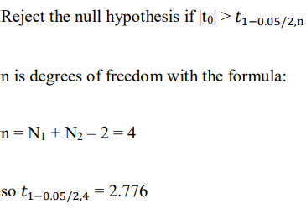
Chapter 5. Modelling
Model validation:
Conclusion: the result shows that the data collected in Arena simulation are reasonable compared to actual data.

Slide 10
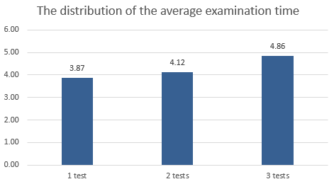
Chapter 6. Result Analysis
1. The total time of patient:
Medical examination performance criteria according to the Ministry of Health regulation. (Decision No 1313 / QD-BYT on April 22, 2013, by the Minister of the Ministry of Health)
One type of test : < 3 hours
Two types of test: < 3.5 hours
Three types of tests: < 4 hours
Number of test types | Difference to criteria (hour)
1 type | 0.87
2 type | 1.12
3 type | 0.86

Slide 11
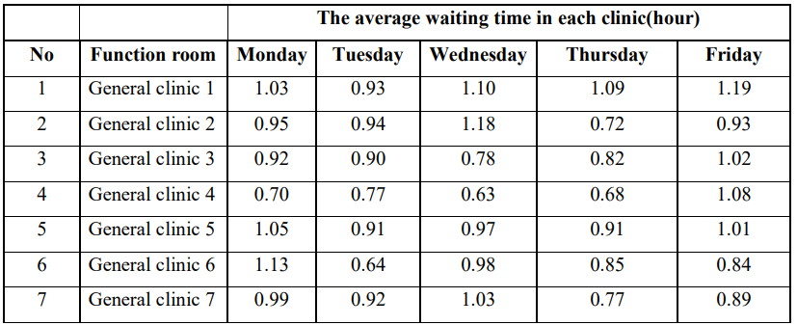
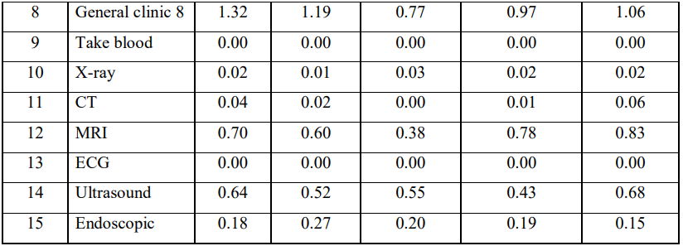
Chapter 6. Result Analysis
2. The waiting time of patient:
General clinic: ~1 hour
Test room:
MRI: 0.38 to 0.83 hours
Ultrasound: 0.43>0.68 hours

Slide 12
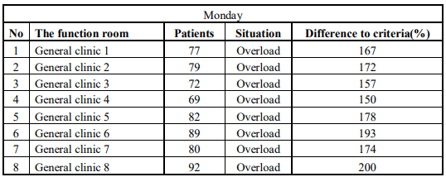
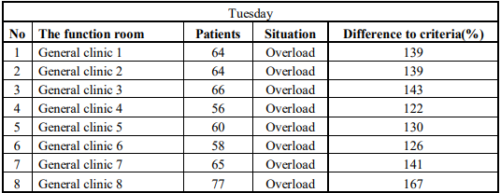
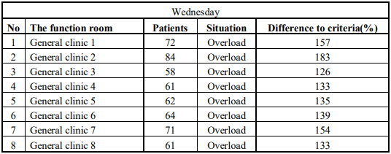
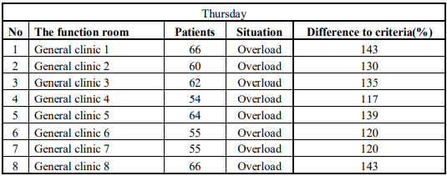
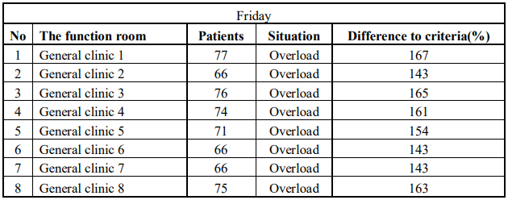
Chapter 6. Result Analysis
3. The number of patients in each clinic:
Medical examination performance criteria according to the Ministry of Health regulation. (Decision No 1313 / QD-BYT on April 22, 2013, by the Minister of the Ministry of Health)
35 patients/ 8 hours as general or 45 patients/ 8 hours if having a sudden increase in the number of patients.
Because the hospital is overcrowding everyday, so the criteria to evaluate will be 46 patients.

Slide 13
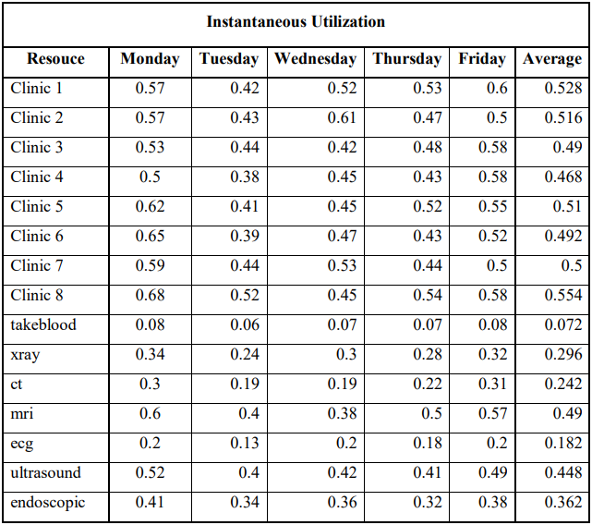
Chapter 6. Result Analysis
4. Utilization of staff:
The utilization in clinic room is just average (about 0.5 per room)
→ Patients are only concentrated in some time frames and a few in the others..

Slide 14
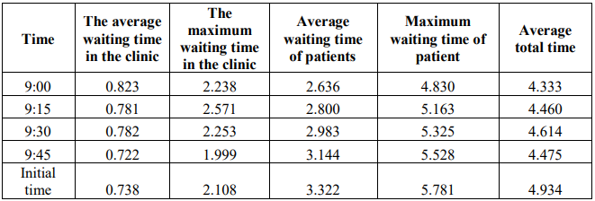
Chapter 7. Improvement suggestion
Suggestion 1: Changing returning examination time to reduce waiting time

Slide 15
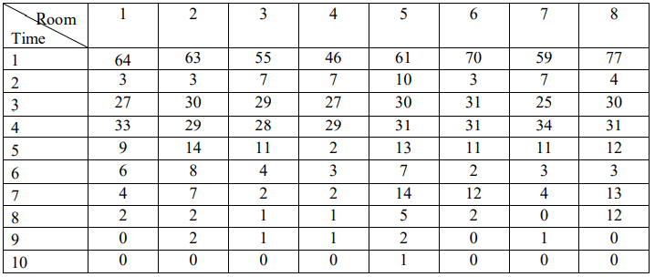
Chapter 7. Improvement suggestion
Suggestion 2: Changing returning examination time and changing doctor's schedule to increase utilization
Using mixed integer linear programming model
8 rooms corresponding to the 8 general clinic rooms, each has maximum 2 doctors
There are 10-time frames, each frame corresponds to 1 hour lasting from 7 am to 5 pm
The number of patients visiting the clinic in each time frame is shown in the table below.

Slide 16
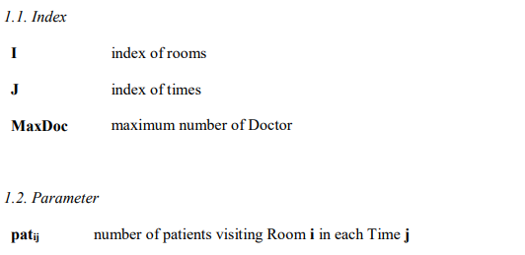
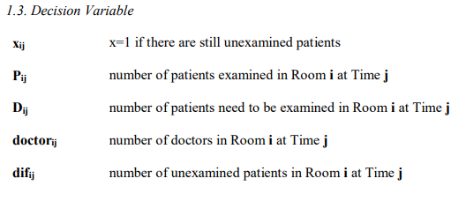
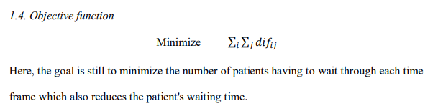
Chapter 7. Improvement suggestion
Suggestion 2: Changing returning examination time and changing doctor's schedule to increase utilization

Slide 17
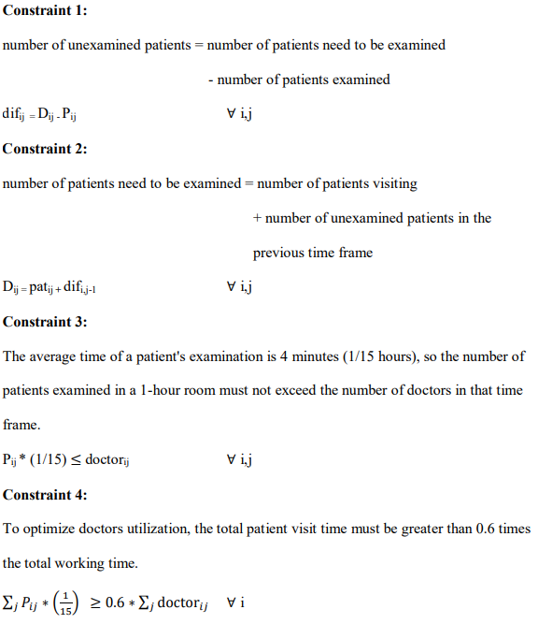
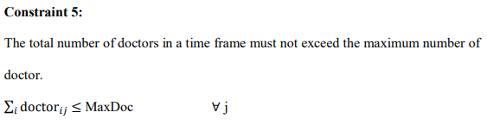
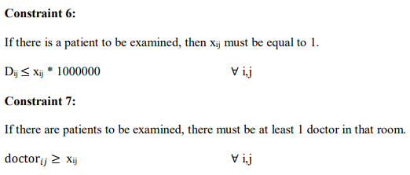
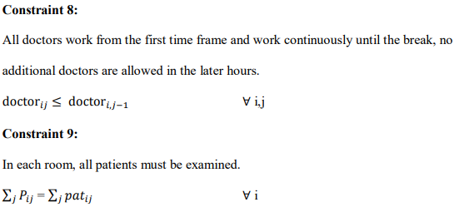
Chapter 7. Improvement suggestion
Suggestion 2: Changing returning examination time and changing doctor's schedule to increase utilization

Slide 18
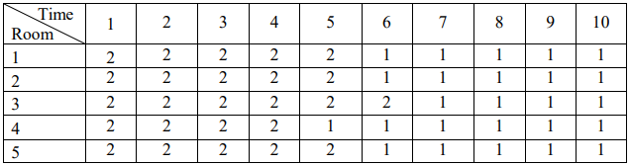
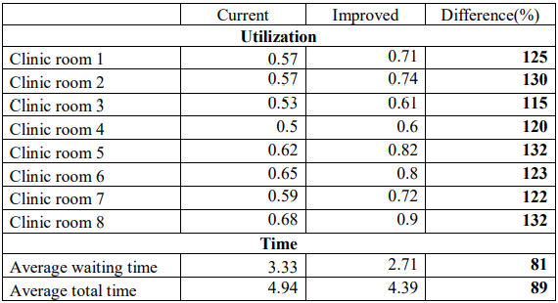

Chapter 7. Improvement suggestion
Suggestion 2: Changing returning examination time and changing doctor's schedule to increase utilization
RESULT:

Slide 19
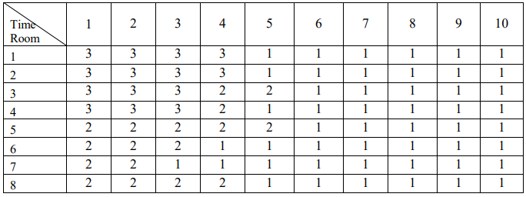
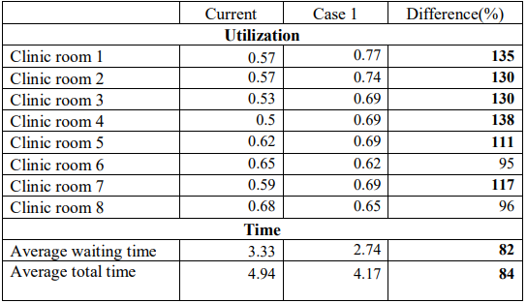

Chapter 7. Improvement suggestion
Suggestion 3: Increasing resources and changing returning examination time to reduce patients waiting time
Case 1: increase by 25% to a total of 20 doctors
The first 4 clinic room will have maximum 3 doctors.
The proportion of will be changed to 15% for a room with 3 doctors and 10% for a room with only 2 doctors.

Slide 20
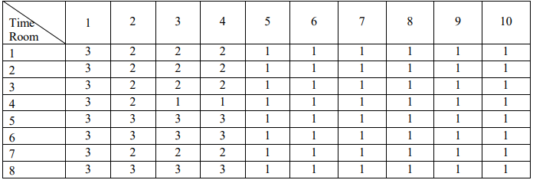
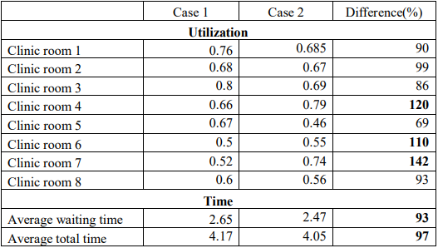
Chapter 7. Improvement suggestion
Suggestion 3: Increasing resources and changing returning examination time to reduce patients waiting time
Case 2: increase by 50% to a total of 24 doctors (The rate in each clinic will be the same at 12.5%)
All the rooms will have a maximum of 3 doctors.

Slide 21
Chapter 8. Conclusion
By applying discrete event simulation in creating a model in Arena simulation software, which can can describe the status of the actual system and finding the shortcomings for it.
The combination of skills learned through subjects such scheduling and operation research was used to create a mixed integer linear programming model to help improve the status of the hospital and reduce patient waiting time.
The improvement which did not increase the resources can reduce the waiting time by 19% and total time by 11%, while the one that increase the resources by 25% reduce by 18% and 16%, respectively.

Slide 22
THANK YOU!

Slide 23
Question & Answer

